Slide 1
Welcome to LABYRINTH RUNNER

Slide 2
What is Labyrinth runner?
Labyrinth runner, a project of team Strawberry, is a console-based single player arcade game, based on the 1980 hit classic Pac-Man.
The player, in the form of a smiley is to collect all gold ($) from all levels to complete the game. The player doesn’t have to complete levels in a linear manner, as he/she is able to freely jump between levels using a pass between two levels

Slide 3
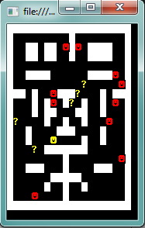
Gameplay
The core game consists of the player, you navigating through a maze,
You initially have 3 lives, which may be extended using bonuses.
You must evade the red ruder shaped enemies in order to survive
Collision with an enemy removes a life, and resets the player back to the start position
Your objective is to evade the enemies and take all of the gold from all levels
Movement is done through the arrow keys, of which escape is used to cancel a game and go back to the menu screen

Slide 4
Repository at: https://github.com/todorm85/TeamStrawberry
Dev team:
Name | Telerik name | GitHub name
Todor Mitskovski | todorm85 | todorm85
Boyan Slavov | boyan.slavov | b-slavov
Angel Vulkov | avalkov | avalkov
Martin Ali | Beardhammer | Beardhammer
Ivaylo Arnaudov | ivaylo.arnaudov | r1f
We hope you enjoy the game ☺

